Slide 1
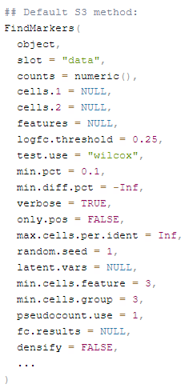
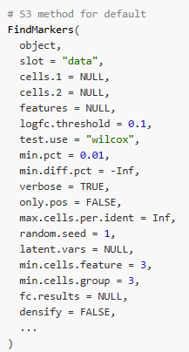
Seurat V4
Seurat V5
Less Conservative = More DEGs

Slide 2
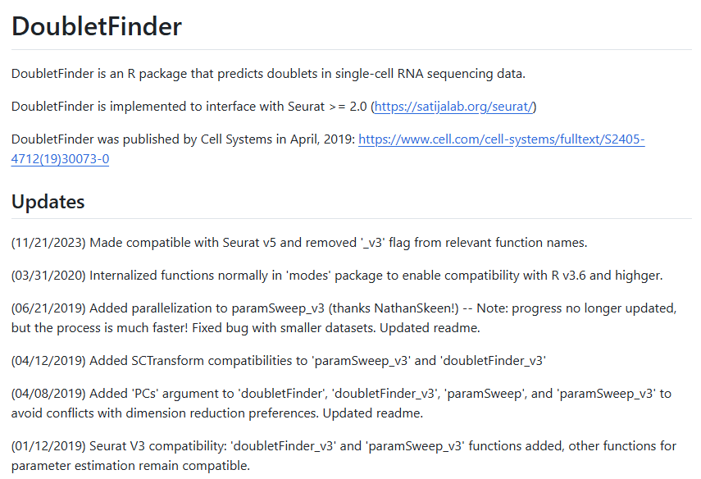

Slide 3

Seurat V5
Seurat V4

Slide 4


Slide 5
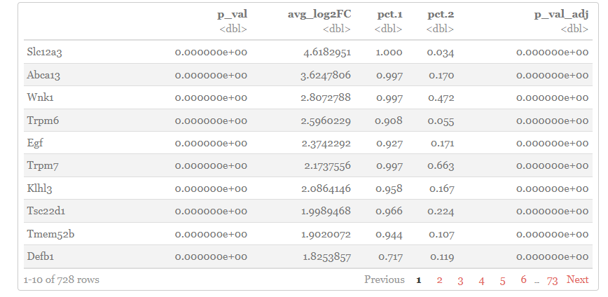
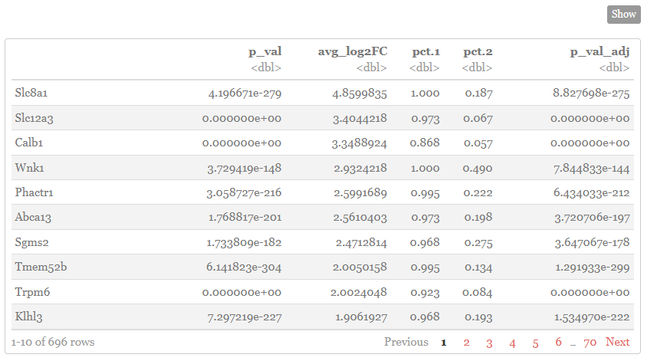
DEG List A
DEG List B
What is Shared (or unshared) between them?

Slide 6
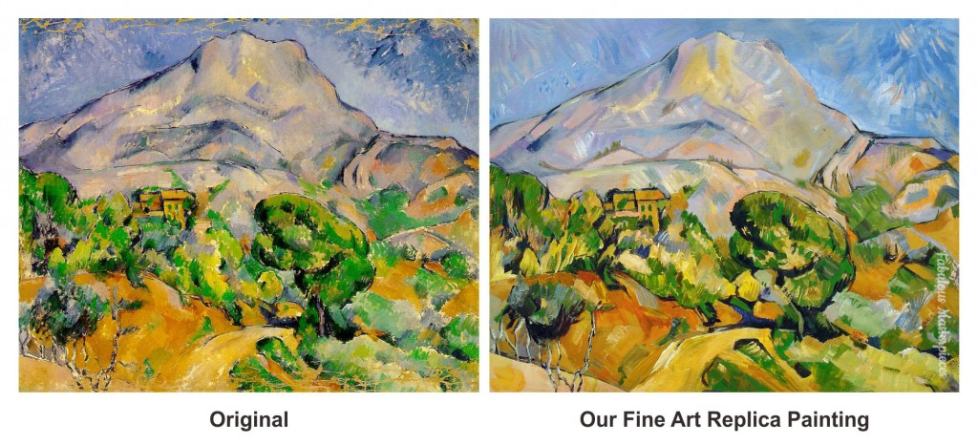

Slide 7

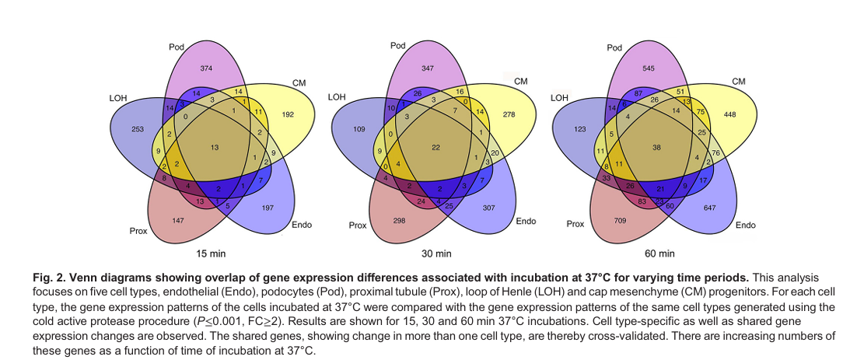

Slide 8


Slide 9

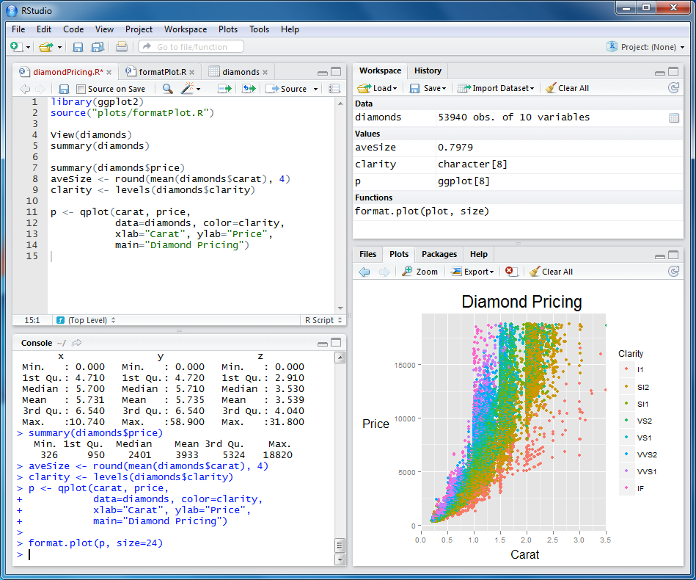

Slide 10


Slide 11


